Slide 1
Southern Water Corp Case Study Technical Presentation
Presenter: Hande Tokgoz Utku
Date:

Slide 2
Rising water demand leads to more production - more wear and pump failures. Discovering the reasons of failures will help improving SWC's revenues and EBIT​.
!
Maximizing the availability of SWC desalination plants to meet continual demand, results in more pump failures due to pump wear. To cope with the demand, SWC needs to understand the reasons of failures to reduce plant maintenance expenses​.
Problem 1
Increased demand leading to increased pump wear
!
Being able to understand when failures happen is vital for being able to get ready for those and take the precautions proactively.
SWC needs to forecast failures better to keep production going (Revenues and EBIT)​
Problem 2
Increased failures impact production negatively during high production
!
There are multiple metrics that SWC is tracking and those change during production fluctuations. These fluctuations range from 1X to 3X and sometimes more. It’s hard to say which one impacts the failures the most without inferential statistics.
Problem 3
It’s hard to know which metrics would be the indicator of a pump failure

Slide 3
Flow Meter 2, Pump Torque, Max Daily Pump Torque and RPM are the indicators of pump failure per the rolling standard deviation model, increasing up to 600% during failures.
Key Insights
Pump Failure is paired with fluctuations and increases of Flow Meter 2, Pump Torque, Max Daily Pump Torque and RPM .
Before and during pump failures, there are changes in the overall rolling standard deviation of those metrics, which goes back to normal when the failure is repaired.
Key regression variables: Flow Meter 2, Pump Torque, Max Daily Pump Torque and RPM .
Source: Southern Water Corp Statistical Records

Slide 4
We applied Descriptive and Inferential statistics to uncover which metrics could be the indicators of pump failure
How can Southern Water Corp. anticipate a pump failure at least 7 days before the failure with a 100% success during the year of 2020?
Descriptive Statistics
Box Plots
Inferential Statistics
Regression

Slide 5
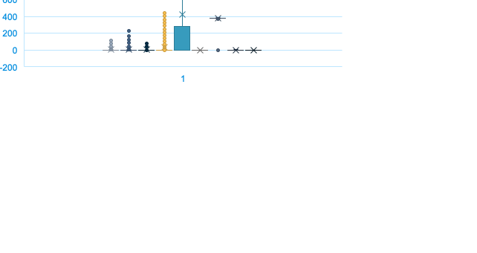
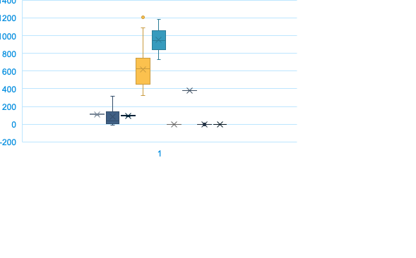
Surjek Pump Torque and Maximum Daily Pump Torque increases would be the major indicators of pump failure per descriptive statistics (shown as yellow and blue below)
Key Insights
YES
Surjek Pump Torque triples when a pump failure happens
Maximum Daily Pump Torque triples when a pump failure happens
Torque metrics are clear indicators of pump failure per our box plots for Failure = YES and Failure = NO
NO

Slide 6
Flow Meter 2, Maximum Daily Pump Torque and Surjek Pump Torque are the main indicators of pump failure per inferential statistics
Key Insights
SURJEK_FLOW_METER_2, MAXIMUM_DAILY_PUMP_TORQUE, and SURJEK_PUMP TORQUE are correlated the most with pump failures with scores close to 0.60
SURJEK_FLOW_METER_1 and ROTATIONAL_PUMP_RPM might be considered as secondary metrics that correlates to pump failure with scores 0.40 and 0.20 respectively.

Slide 7
Plot of Actual Failures vs Regression Results
We can roughly anticipate the pump failures with our regression equation, but we might have false positives as marked.

